Slide 1
Cloud Computing
Notes:
https://courses.cs.washington.edu/courses/cse403/13au/lectures/git.ppt.pdf
http://enos.itcollege.ee/~jpoial/allalaadimised/git/getting-started-with-git.pdf

Slide 2
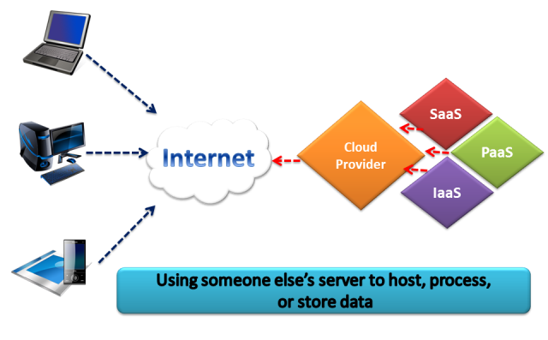
What is Cloud?

Slide 3
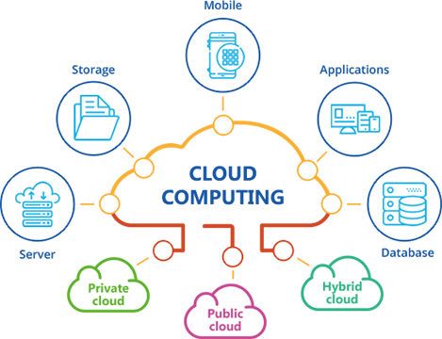
Cloud Computing
Enables network access to computing resources:
Networks,
Servers,
Storage,
Applications
Services
Resources can be rapidly provisioned

Slide 4
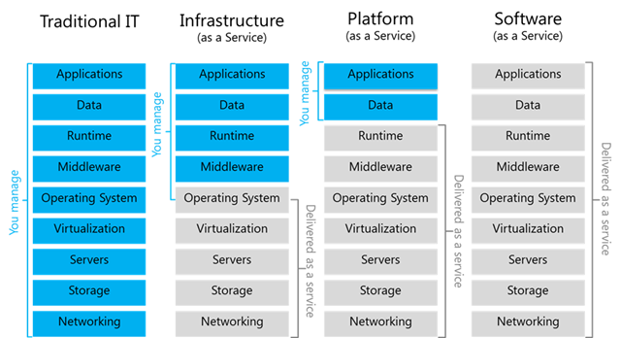
Cloud Services Models

Slide 5
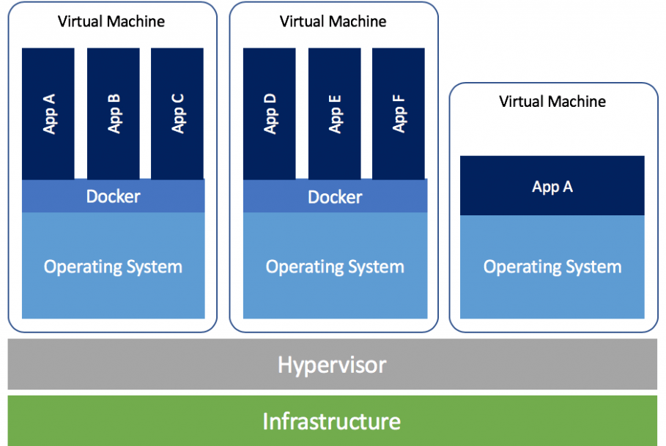
Virtual Machines
VM technology allows multiple virtual machines to run on a single physical machine

Slide 6
Top cloud applications
Mail and Messaging
Archiving
Backup
Storage
Security
Virtual Servers
CRM
Collaboration across enterprises

Slide 7
Explore key cloud concepts
High availability
Fault tolerance
Scalability
Elasticity
Global reach
Predictive cost
Agility
Security
Disaster recovery
Notes:
There is a term reference guide available at https://azure.microsoft.com/en-us/overview/cloud-computing-dictionary/

Slide 8
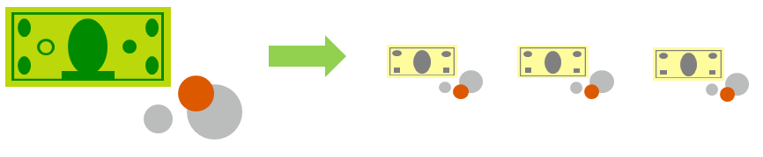
Compare CapEx vs. OpEx
Capital Expenditure (CapEx)
High upfront cost
Value of investment reduces over time.
Operational Expenditure (OpEx)
Spend as needed.
No upfront cost, pay-as-you use.

Slide 9
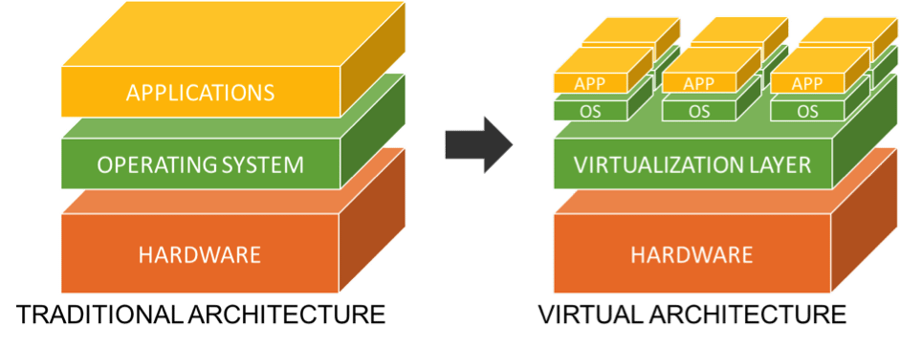
What is Virtualization?

Slide 10
Microsoft Azure Core Services

Slide 11
Examine Regions
Provides flexibility and scale.
Preserves data residency.
Select regions close to your users.
Worldwide there are 50+ regions representing 140 countries
Notes:
A list of regions and their locations is available at https://azure.microsoft.com/en-us/global-infrastructure/locations/
A region represents a collection of datacenters.
Provides flexibility and scale.
Preserves data residency.
Select regions close to your users.
Be aware of region deployment availability.
There are global services that are region independent.

Slide 12
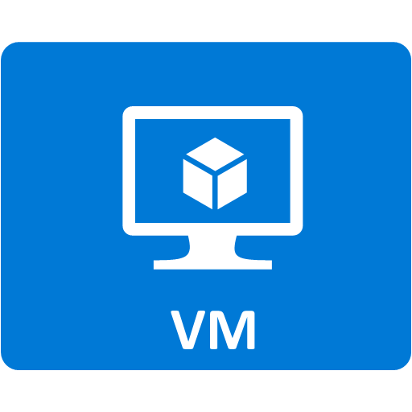


Explore Resource groups
Resource groups (web + DB, VM, Storage) in one group
Containers for multiple resources that share the same life cycle.
OR
Web and DB resource group
Virtual machine resource group
Storage resource group
Notes:
Containers for multiple resources that share the same life cycle.
Aggregates resources into a single manageable unit.
Every Azure resource must exist in one (and only one) resource group.
Secure at the resource group (or resource) level - using role-based access control (RBAC).

Slide 13
Walkthrough – Create a Virtual Machine
Create a virtual machine, connect to the virtual machine
Create the virtual machine.
Connect to the virtual machine.

Slide 14
Walkthrough – Create Blob storage
Create a storage account with a blob storage container. Work with blob files.
Create a storage account.
Work with blob storage.

Slide 15
Thanks

